Slide 1


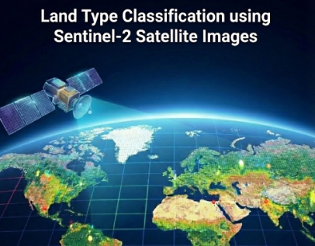

Satellite AI Vision
1- Tadrous Adel William
2- Maria Ashraf Haleem
3- Abdelaziz Hassan Fouad
4- Karen Medhat Zaher
5- Mohamed Essam
6- Mohamed Kamal

Slide 2
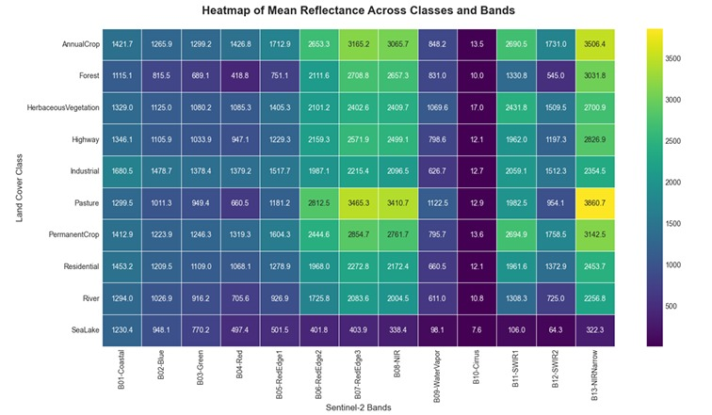
Problem Definition:
Traditional remote sensing methods rely on manual feature extraction, which is time-consuming and limited in handling the high dimensionality of multispectral data, hindering effective urban planning and resource management.

Slide 3
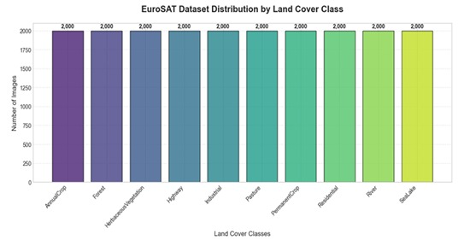
Project Background & Data Overview
Objective: We built a Deep Learning model to automatically classify land into 10 distinct types (e.g., Forests, Industrial, Rivers)
Data Source: utilized the EuroSat Dataset, derived from Sentinel-2 Satellite imagery.
Why It's Special: The data is Multispectral (13 Bands). It uses invisible Near-Infrared light to detect vegetation health better than the human eye.

Slide 4
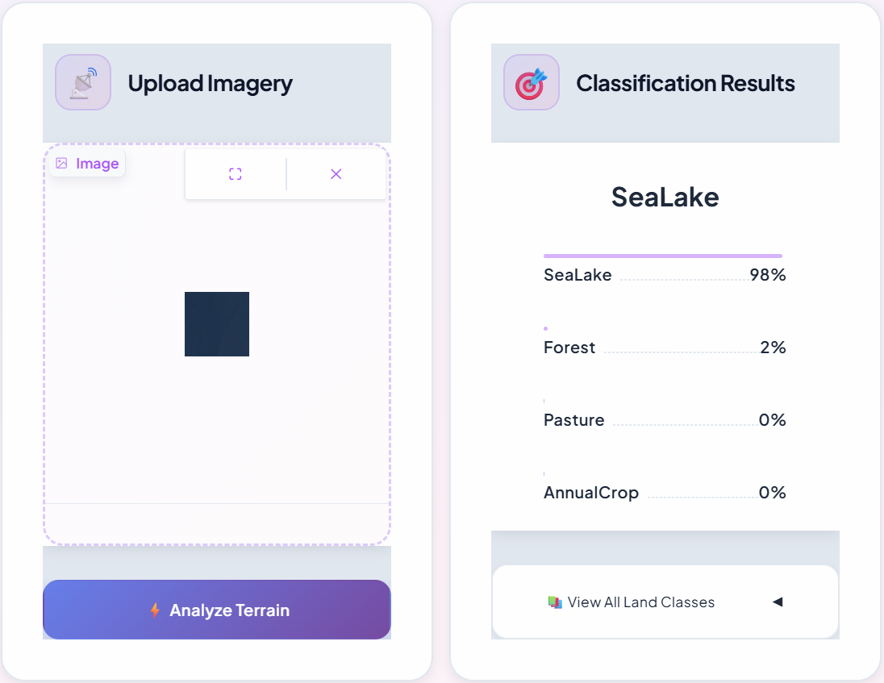
proposed solution :
Automated System: Leverages EfficientNet-B0 to classify Sentinel-2 imagery into 10 distinct land cover classes.
Unique value proposition :
Achieved 97.12% accuracy using EfficientNet-B0, ensuring high efficiency and low computational cost for scalable deployment.

Slide 5
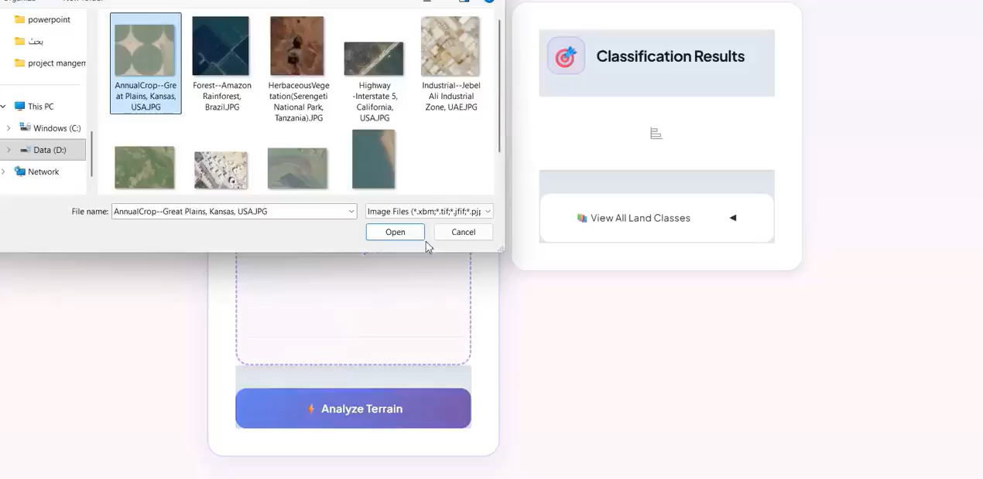

Slide 6




Data Acquisition & Collection
Source: https://github.com/Tadrous701/DEPI-final-Project- Graduation/releases/tag/v1.0.0
Scale: Comprises 27,000 labeled images covering 10 distinct land cover classes (e.g., Forest, Industrial).
Spectral Depth: Includes 13 multispectral bands (Visible + Near-Infrared) for enhanced feature detection.
Balance: A perfectly balanced dataset (~2,000–3,000 images/class), preventing model bias.
Technologies Used:Pandas & NumPy (Data Handling & Loading)

Slide 7
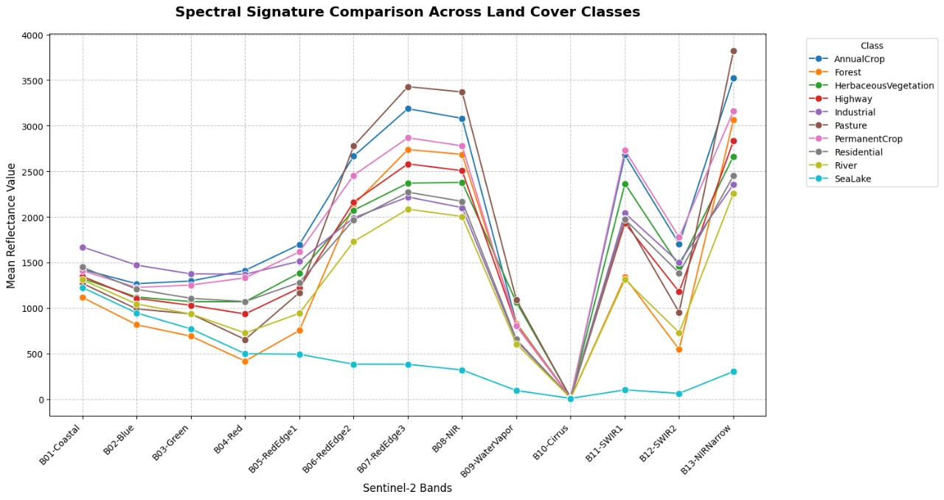
Data Exploration & Spectral Analysis
Spectral Analysis: We analyzed 13 distinct bands to identify unique "signatures" for each land type (e.g., Vegetation vs. Water) .
Image Enhancement: Applied Contrast Stretching to convert dark, raw satellite data into clear, human-readable images.
Data Splitting: Rigorously split data into Train (60%), Validation (20%), and Test (20%) to ensure valid results.
Technologies Used: Core analysis relied on the Python Data Stack (NumPy, Pandas) and visualization libraries (Matplotlib, Seaborn) for calculating and plotting NDVI/Spectral Signatures.

Slide 8
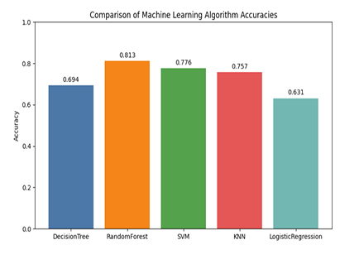
The Algorithm Baseline
Initial Benchmark: We established a performance baseline using traditional Machine Learning (ML) algorithms.
Best Result: The Random Forest model achieved the highest traditional accuracy, reaching 81.3%
The Limitation: These models relied on manual feature extraction and failed to capture the complex patterns in the raw multispectral data.
The Shift: The 81.3% accuracy was suboptimal, demanding a necessary transition to Convolutional Neural Networks (CNNs) for superior, automated learning.

Slide 9
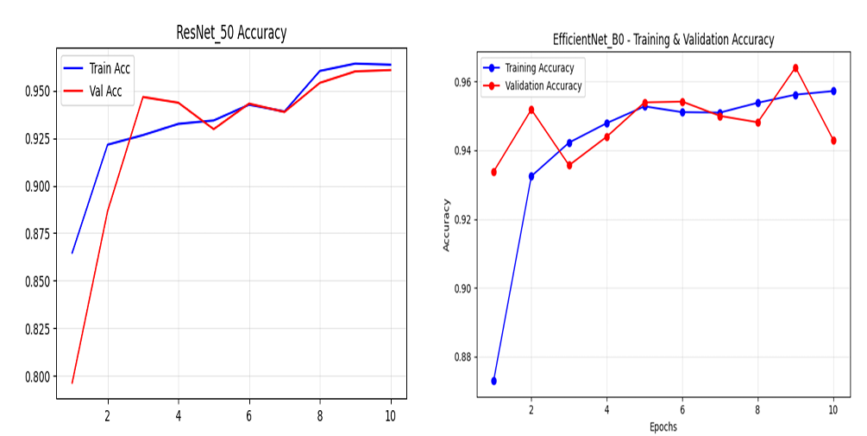
Model Selection
Architectures Tested: We compared two advanced architectures: ResNet-50 and the newer EfficientNet-B0
The Best Fit: EfficientNet-B0 was selected as the optimal model for its balance of high accuracy and superior computational efficiency.
The Advantage: EfficientNet uses Compound Scaling to simultaneously optimize the model's depth, width, and resolution.
Technologies Used: utilized the PyTorch framework and employed Transfer Learning to optimize the final EfficientNet-B0 architecture

Slide 10
Project Deliverables
A functional Beta prototype: is deployed on Hugging Face Spaces using Gradio.
Trained Model Weights: The final optimized EfficientNet-B0 model file is ready for production use.
Source Code Repository: The complete codebase for the data pipeline and model inference
Technical Report: A comprehensive document detailing the preprocessing pipeline and EfficientNet-B0 architecture
Project Documentation: Documentation covering the implementation strategy and user guidelines

Slide 11
Thank you
Email: tadoadel2005@gmail.com
We are now open to any questions or feedback you may have

